Slide 1
Accelerating String Matching on Graphic Processing Units
Cheng-Hung Lin
National Taiwan Normal University
Taipei, Taiwan

Slide 2
Outline
Introduction
Parallel Failureless Aho-Corasick Algorithm
Memory-Efficient Memory Architecture
M-DFA (Multithreaded DFA) for Regex Matching
Notes:
The flow of my presentation is as follows.
First, I will introduce what is PFAC library.
Second, I will review a traditional string matching algorithm
Then, I will present the Parallel Failureless Aho-Corasick Algorithm
Finally, I will give the experimental results and conclusions.

Slide 3
String Matching
String matching engine plays an important role in many applications, such as network intrusion detection systems, spam filters, and bioinformatics.
String matching is used to find a place where one or several strings (also called patterns) are found within a larger string or text.
Patterns
“TACT”
“CTO”
“TOE”
Input string
T A C T O E
T A C T
C T O
T O E

Slide 4
Aho-Corasick Algorithm
Aho-Corasick algorithm has been widely used for string matching due to its advantage of matching multiple string patterns in a single pass
Aho-Corasick algorithm compiles multiple string patterns into a state machine
2
E
3
“TACT”
“TOE”
“CTO”
[^TC]
O
0
T
1
A
4
C
5
T
6
C
7
T
8
O
9
Notes:
Before we discuss the kernel of the PFAC algorithm, we would like to review a traditional Aho-Corasick algorithm which has been widely used for string matching due to its advantage of matching multiple string patterns in a single pass
Using Aho-Corasick algorithm has two steps.
First, Aho-Corasick algorithm compiles multiple string patterns into a state machine
Consider the three string patterns “TACT”, “TOE”, and “CTO”
This figure shows the Aho-Corasick state machine where the solid lines represent valid transitions and dotted lines represent failure transitions.

Slide 5
Aho-Corasick Algorithm (cont.)
String matching is performed by traversing the Aho-Corasick (AC) state machine
Failure transitions are used to backtrack the state machine to recognize patterns in different locations.
1 2 3 4 5 6
T A C T O E
2
E
3
[^TC]
O
0
T
1
A
4
C
5
T
6
TOE
CTO
C
7
T
8
O
9
TACT
Notes:
Then in the second step, the Aho-Corasick algorithm performs string matching by traversing the Aho-Corasick (AC) state machine.
For example, consider to match the string TACTOE using one thread to traverse the AC state machine.
By taking the inputs TACT, the state machine traverses from state 0 to state 6 which indicates the pattern TACT is matched at position 4.
Then the machine takes the input O, because there is no valid transition for the input O at the state 6, the machine takes the failure transition to state 8 and reconsider the input O, then goes to state 9 which indicated the pattern CTO is matched at position 5. Finally, the machine takes the input E, also because there is no valid transition for the input E at state 9, the machine takes the failure transition to state 2 and then goes to state 3 which indicates the pattern TOE is matched at position 6.
By traversing the state machine, the three pattern are found at the three positions respectively.

Slide 6
Naïve Data Parallel Approach
Partition an input stream into multiple segments and assign each segment a thread to traverse AC state machine
Boundary detection problem
Pattern occurs in the boundary of adjacent segments.
Duration time of threads = segment size + longest pattern length – 1
TOETACTOXXXXX
Notes:
This slide shows a naïve data parallel approach which partitions an input stream into multiple segments and assign each segments a thread to traverse the AC state machine.
However, the data parallel approach has the boundary detection problem that the pattern occurring in the boundary of adjacent segments cannot be found.
In order to solve the boundary detection problem, each thread must scan across the boundary.
Therefore, each thread has a fixed duration time that equals to the segment size plus the longest pattern length minus 1.
We would to mention that the fixed and long duration time of thread is not proper for GPU implementation.

Slide 7
Parallel Failureless Aho-Corasick Algorithm
Parallel Failureless Aho-Corasick (PFAC) algorithm on graphic processing units
Allocate each byte of input an individual thread to traverse a state machine
Reference:
C.-H. Lin et al., "Accelerating String Matching Using Multi-Threaded Algorithm on GPU," in GLOBECOM 2010.
C.-H. Lin et al., “Accelerating Pattern Matching Using a Novel Parallel Algorithm on GPUs” accepted by IEEE Transactions on Computers
…………………
TOETACTOXXXXXXXX
……………
Notes:
In Globecom 2010, we have proposed a new parallel approach called Parallel Failureless Aho-Corasick algorithm.
As shown in this figure, the new approach allocates each byte of input an individual thread to the state machine.
Each thread is only responsible to check whether any pattern occurs in the thread starting position.
This method sounds like a brute force approach. But, it is definitely different from brute force method.
First, it has the same functionality as the traditional AC algorithm.
Second, the state machine is much smaller than the Aho-Corasick state machine.
Third, the memory

Slide 8
Failureless-AC State Machine
Remove all failure transitions as well as the self-loop transitions backing to the initial state
Minimum number of valid transitions
Thread is terminated when no valid transitions
E
2
E
2
3
3
O
[^TC]
O
A
A
C
C
T
T
T
0
T
0
1
1
4
4
5
5
6
6
C
C
T
T
O
7
O
7
8
8
9
9
Notes:
Therefore, we can simplify the AC state machine by removing all failure transitions as well as the self-loop transitions backing to the initial state.
We call the new state machine as Failureless-AC State Machine.
Failureless-AC State Machine has minimum number of transitions.
When a thread is used to traverse the Failureless-AC State Machine, it is terminated when no valid transitions for an input character.

Slide 9
Mechanism of PFAC
n+3
n
… X X X X T A C T O E X X …
n+2
7
E
1
7
E
1
7
E
1
O
O
O
3
T
4
A
5
C
6
T
0
3
T
4
A
5
C
6
T
0
3
T
4
A
5
C
6
T
0
C
C
C
8
T
9
O
2
8
T
9
O
2
8
T
9
O
2
Thread# n
Thread# n+2
Thread# n+3
Notes:
We use an example to illustrate the mechanism of PFAC algorithm.
Unlike the traditional AC algorithm using one thread to find the three patterns, PFAC finds the three patterns by the thread n, thread n+2 and thread n+3, respectively
In the meantime, the other threads have been terminated in the early stages.

Slide 10
Experimental Environment
Intel CoreTM i7-950
Quad cores
12GB DDR3 memory
Nvidia® GeForce® GTX580
512 cores
1536MB GDDR5 memory
Patterns: String pattern extracted from Snort V2.8, containing 27754 states, 1998 final states (patterns)
Input: extracted from DEFCON
Notes:
The experimental setup has two machines: the host machine and the device machine.
The host machine is equipped with an Intel CoreTM i7-950 while the device machine is equipped with the Nvidia® GeForce® GTX580.
The test patterns are extracted from the Snort and the test input is extracted from DEFCON packets.

Slide 11
Implementations
AC_{CPU} : implementation of the AC algorithm on the CoreTM i7 using a single thread and optimized by GCC 4.4.3 using the compiler flags “-O2 –msse4”.
DPAC_{OMP}: implementation of the DPAC algorithm on Intel CoreTM i7 CPU with OpenMP and optimized by GCC 4.4.3 using the compiler flags “-O2 –msse4”.
PFAC_{OMP}: implementation of the PFAC algorithm on Intel CoreTM i7 CPU with the OpenMP and optimized by GCC 4.4.3 using the compiler flags “-O2 –msse4”.
PFAC_{GPU}: implementation of the PFAC algorithm on NVIDIA GPUs.
Notes:
We have four equivalent implementations for comparisons.
The AC_CPU denotes the implementation of the AC algorithm on the CoreTM i7 using a single thread.
The DPAC_OMP denotes the implementation of the DPAC algorithm on Intel CoreTM i7 CPU with OpenMP.
The PFAC_OMP denotes the implementation of the PFAC algorithm on Intel CoreTM i7 CPU with the OpenMP.
The PFAC_GPU denotes the implementation of the PFAC algorithm on NVIDIA GPUs

Slide 12
Performance Evaluation
Raw data throughput =
Notes:
However, we are much more interested in the performance of GPU performing string matching. Here we define another metric to evaluate the performance.
The raw data throughput equals to the input size divided by the GPU time without considering the transfer time of moving data from host to device and device to host.
In average, the GPU implementation has 75 times faster than the AC_CPU and 15 times faster than the DPAC_OMP implementation.
In addition, we can find that the PFAC is not only suitable to be implemented on GPU but also on multiple core CPU.

Slide 13
PFAC Library
PFAC is an open source library for multiple string matching performed on Nvidia GPUs.
PFAC runs on Nvidia GPUs that support CUDA, including NVIDIA 1.1, 1.2, 1.3, 2.0 and 2.1 architectures.
Supporting OS includes ubuntu, Fedora and MAC OS.
Released at Google code project
http://code.google.com/p/pfac/
Provides C-style API
Users don’t need to have background of GPU programming
Notes:
In the beginning of this talk, I would like to introduce an open source library we released last year.
PFAC is an open source library for multiple string matching performed on Nvidia GPUs.
PFAC runs on Nvidia GPUs that support CUDA, including NVIDIA 1.1, 1.2, 1.3, 2.0 and 2.1 architectures.
Supporting OS includes ubuntu, Fedora and MAC OS.
The PFAC library is released on Google code project
http://code.google.com/p/pfac/
provides C-style API
So that users don’t need to have background on GPU computing or parallel computing.

Slide 14


Using PFAC Library for Multiple String Matching
Notes:
Using PFAC library for string matching is very simple.
We use a simple example to demonstrate how to match the four pattern against the input stream.

Slide 15
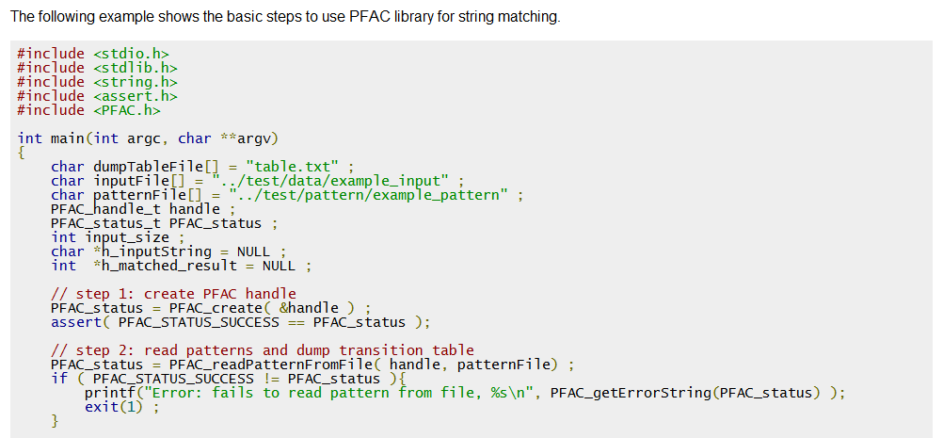
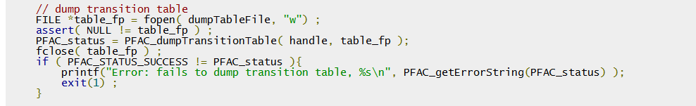
Five Steps to Use PFAC for String Matching
Notes:
All you have to do is to follow the 5 steps.
First is to create a PFAC handle.
Second is to read patterns and dump transition table to GPU.

Slide 16
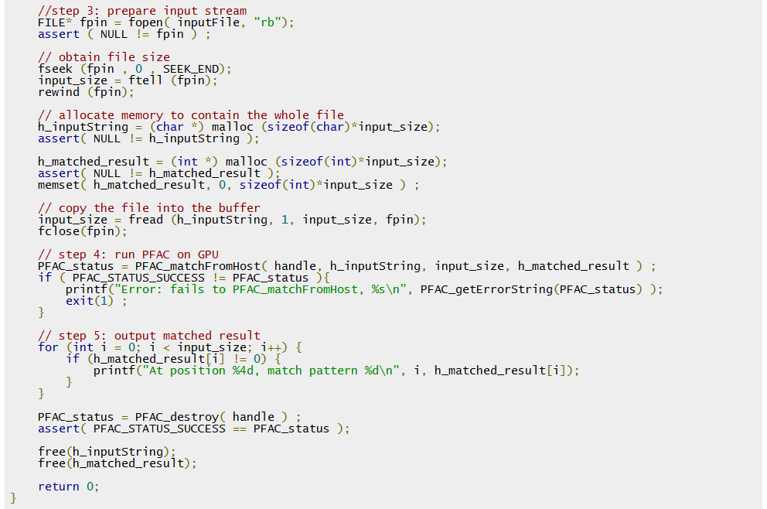
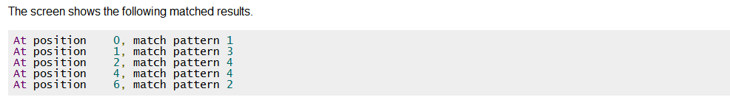
Notes:
The third step is to prepare the input stream.
The fourth step is the run string matching on GPU
Finally, the fifth step is to output matched result.
Then, you see the matched results which indicate at which position, match which pattern

Slide 17
Outline
Introduction
Parallel Failureless Aho-Corasick Algorithm
Memory-Efficient Memory Architecture
M-DFA (Multithreaded DFA) for Regex Matching
Notes:
The flow of my presentation is as follows.
First, I will introduce what is PFAC library.
Second, I will review a traditional string matching algorithm
Then, I will present the Parallel Failureless Aho-Corasick Algorithm
Finally, I will give the experimental results and conclusions.

Slide 18
Memory Issue of PFAC
The two-dimensional memory is sparse.
Each row (state) needs 1K (256 x 4)bytes
A state machine with 1M states needs 1G bytes
99% of memory is wasted
Design a compact storage mechanism for storing PFAC state transition table is essential for GPU implementation.
NS1
NS2
…
NS256
7
E
1
state
O
3
T
4
A
5
C
6
T
0
C
char
256:1 MUX
8
T
9
O
2
next state
Notes:
We recall the two-dimensional memory architecture used for string matching.
The two-dimensional memory is used to store state transition table.
In the two-dimensional memory, each row represents a state and contains 256 columns for storing the next state information for ASCII alphabets. The current state and the input character are used to retrieve the information of the next state and the match vector from the memory.
As the state machine we proposed has removed all failure transitions. Therefore, more than 99% of memory is wasted.

Slide 19
Perfect Hashing Memory Architecture
Use a perfect hash function to store only valid transitions of a PFAC state machine in a hash table
Reference
C.-H. Lin, et al. "Memory-Efficient Pattern Matching Architectures Using Perfect Hashing on Graphic Processing Units,” in IEEE INFOCOM, 2012
3
T
4
A
5
C
6
Hash table memory
Hash table memory
Hash value (index)
key
Next state
Key(transition)
Hash value (index)
key
next state
Key(transition)
Perfect
Hash
Function
Perfect
Hash
Function
{3:’T’}
4
state
Char
state
Char
{4:’A’}
5
{5:’C’}
6
next state
next state
Notes:
Our main idea is use perfect hashing to store only valid transitions of a reduced DFA so that we can achieve memory reduction.
The hash table has two columns, one is for storing valid transitions as key. The other is for storing the next state for each valid transition.
For example, consider the partial state machine. The hash table only stores the three valid transitions.
We adopt perfect hashing because Perfect hash function guarantees no collisions when mapping key to a distinct hash value.
However, the complexity of a perfect hash function degrades the performance. In the following, we first propose a hardware-friendly perfect hash function and then propose two perfect hashing memory architectures in terms of space and performance.

Slide 20
Hardware-friendly Perfect Hash Function
Slide-Left-then-Right First-Fit (SLRFF) algorithm
Steps to create PHF table
Start with a two-dimensional table of width w and place each key k at location (row, col), where row = k / w, col = k mod w.
Rows are prioritized by the number of keys in it and move rows in order of priority as following steps.
First, slide the row left to let the first key in the row be aligned at the first column.
Then, slide the row right until each column has only one key and record the offset in an array.
Collapse the two-dimensional key table to a linear array.
Reference
R. E. Tarjan and A. C.-C. Yao, "Storing a sparse table," Commun. ACM, vol. 22, pp. 606-611, 1979.
Notes:
We modified a classic perfect hash function and propose a Slide-Left-then-Right First-Fit (SLRFF) algorithm to construct a perfect hash function.
The algorithm has three steps.
The first step is to start with a two-dimensional table and put each key into the table.
The second step is to sift each row until no two keys appear in the same column.
The final step is to collapse the two-dimensional table to a linear table.

Slide 21
Step 1 of Creating PHF
Key set, S = {2, 4, 10, 11, 13, 14, 17, 20, 21, 25, 27}
Start with a two-dimensional table of width w and place each key k at location (row, column), where row = k / w , column = k mod w.
Key table (w = 8)
 |  | 2 |  | 4
 |  | 10 | 11 |  | 13 | 14
 | 17 |  |  | 20 | 21
 | 25 |  | 27
Notes:
We use an example to demonstrate the perfect hash function.
Consider a key set S containing the eleven keys.
We start with a two-dimensional table of width 8 and put keys into the table using the above equations.

Slide 22
Step 2 of Creating PHF
Rows are prioritized by the number of keys in it
According to the order of priority
Slide each row left to let the first key be aligned at the first column.
Slide each row right until each column has only one key and record the offset in the array RT.
RT[0] =
RT[1] =
RT[2] =
RT[3] =
 |  | 2 |  | 4
5
3
0
-2
 |  | 10 | 11 |  | 13 | 14
1
0
1
 | 17 |  |  | 20 | 21
2
0
0
 | 25 |  | 27
4
6
Notes:
In the second step, rows are prioritized by the number of keys in it.
For example, the second row has the first priority because it has 4 keys.
Then, according to the order of priority, we slide each row left first and then right to the position until no two keys appear in the same column.
And, record the offset in the RT array.
For example, we slide the second row which has the first priority left and record the offset -2 in the RT[1].
Then, we slide the third row left then right and record the offset 1 in RT[2].

Slide 23
Step 3 of Creating PHF
Collapse the two-dimensional table to a linear table HK.
RT[0] = 5
RT[1] = -2
RT[2] = 1
RT[3] = 6
 |  | 2 |  | 4
10 | 11 |  | 13 | 14
 | 17 |  |  | 20 | 21
 | 25 |  | 27
HK :
10 | 11 | 17 | 13 | 14 | 20 | 21 | 2 | 25 | 4 | 27
Notes:
In the final step, the two-dimensional table is collapsed into a linear table HK.
In our application, the HK table is used to store valid transitions as keys.

Slide 24
Computation of Hash Value
row = k / w ;
col = k mod w ;
index = RT[row] + col ;
If HK[index] == k k is a valid key ; else k is an invalid key ;
For example:
Given k = 14
row = 14 / 8 = 1
col = 14 mod 8 = 6
index = RT[1] + 6 = -2 + 6 = 4
HK[4] =14
14 is a valid key
RT[0] = 5
RT[1] = -2
RT[2] = 1
RT[3] = 6
index :
0 | 1 | 2 | 3 | 4 | 5 | 6 | 7 | 8 | 9 | 10
HK :
10 | 11 | 17 | 13 | 14 | 20 | 21 | 2 | 25 | 4 | 27
Notes:
Given a key, the procedure shows how to compute the hash value.
For example, given a key k 14.
The row is the floor of 14 divided by 8 and is equal to 1
The column is 14 mod 8 and is equal to 6.
The index is the row offset stored in RT[1] plus 6 and is equal to 4
Then, we lookup the key stored in HK[4] and compare with the input key . Because they are matched, we know 14 is a valid key.
Therefore, we can retrieve the data in NS[4] as the next state.

Slide 25
Computation of Hash Value
row = k / w ;
col = k mod w ;
index = RT[row] + col ;
If HK[index] == k k is a valid key ; else k is an invalid key ;
For example:
Given k = 19
row = 19 / 8 = 2
col = 19 mod 8 = 3
index = RT[2] + 3 = 1 + 3 = 4
HK[4] =14
19 is an invalid key
RT[0] = 5
RT[1] = -2
RT[2] = 1
RT[3] = 6
index :
0 | 1 | 2 | 3 | 4 | 5 | 6 | 7 | 8 | 9 | 10
HK :
10 | 11 | 17 | 13 | 14 | 20 | 21 | 2 | 25 | 4 | 27
Notes:
Given a key, the procedure shows how to compute the hash value.
For example, given a key k 14.
The row is the floor of 14 divided by 8 and is equal to 1
The column is 14 mod 8 and is equal to 6.
The index is the row offset stored in RT[1] plus 6 and is equal to 4
Then, we lookup the key stored in HK[4] and compare with the input key . Because they are matched, we know 14 is a valid key.
Therefore, we can retrieve the data in NS[4] as the next state.

Slide 26
Perfect Hashing Memory Architecture
Algorithm
row = k / w ;
col = k mod w ;
index = RT[row] + col ;
If HK[index] == k k is a valid key ; else k is an invalid key ;
If k is a valid key nextState = NS[index] ; else nextState = trap state;
state
char
HK
NS
key
key | Next state
PHF
mod
col
index
HK Size
+
>>
row
RT
Comparator
nextState
trap state
Notes:
This figure shows the perfect hashing memory architecture.
The NS column is associated to the HK table to store the next state information corresponding to each valid transition.
The comparator is used to compare the input key with the valid key stored in HK table. If they are matched, the state is updated as the next state stored in NS table; otherwise, the state is updated as the trap state.

Slide 27
Experimental Environment
Intel CoreTM i7-950
Quad cores
12GB DDR3 memory
Nvidia® GeForce® GTX580
512 cores
1536MB GDDR5 memory
Patterns: String pattern extracted from Snort V2.8, containing 126,776 states, 10,076 final states (patterns)
Input: 256MB packets extracted from DEFCON

Slide 28
Experimental Results
 | # of Rules | # of char | Memory (Bytes) |  | Throughput (Gbps)
PHM | 10K | 187K | 620KB | 3.39B | 100.76
 | 2K | 41K | 137KB | 3.34B | 135.93
PFAC | 2K | 41K | 27.1MB | 677B | 146.63
B-FSM | 39.5K | 25.2K | 188KB | 7.4B | 2
CDFA | 1,785 | 29.0K | 129KB~ 256KB | 4.45B~ 8.2B | 11.7
Bitmap Compression | 1.5K | 18.2K | 2.8MB | 154B | 7.6
Path Compression | 1.5K | 18.2K | 1.1MB | 60B | 7.6
*PHM : Perfect Hashing Memory Architecture
Notes:
This table compares the proposed architecture with PFAC and the other stat-of-the-art memory reduction approaches.
The second and third column show the number of rules and characters. The fourth column and the fifth column show the total memory and the average memory per character. The last column shows the throughput.
The PFAC has the best performance but consumes a lot of memory.
Compared with PFAC, PHM achieves significant memory reduction with a little degradation of performance.
13’ 07”

Slide 29
Conclusions
The PFAC algorithm is adaptive to be implemented on GPUs and multicore CPUs.
The perfect hash algorithm significantly reduces the memory for storing state transition table with little penalty on performance.
Notes:
We have proposed novel memory architectures which adopt a low-complexity perfect hash function to condense the state transition table.
We have implemented the proposed architectures on GPUs which outperform to state-of-the-art approaches both on performance and memory reduction.

Slide 30
M-DFA (Multithreaded DFA): An Algorithm for Reduction of State Transitions and Acceleration of REGEXP Matching
Cheng-Hung Lin National Taiwan Normal University Taipei, Taiwan brucelin@ntnu.edu.tw | Jyh-Charn Liu Dept. of Computer Science & Engineering Texas A&M University liu@cse.tamu.edu

Slide 31
Regular Expression Matching
Regular Expression (REGEXP) matching is typically implemented as a nondeterministic finite automaton (NFA) or its equivalent deterministic finite automata (DFA).
NFA has smaller sizes in terms of memory space, but it may take multiple cycles to match an input symbol when multiple states become active concurrently.
An NFA can be mapped to its DFA equivalence by mapping concurrent active states in NFA to one single active state in the DFA.
State explosion arises during integration of multiple regexps into a DFA

Slide 32
NFA and DFA
NFA of “[abc]x” and “c[xy]”
DFA
1
[abc]
x
state | Match Patterns
4 | “[abc]x”
5 | “c[xy]”
ε
2
4
c
[xy]
3
5
[^abc]
[^abcx]
[ab]
[ab]
[^abc]
1
[ab]
2
x
4
[ab]
c
c
[ab]
c
3
x
6
state | Match Patterns
4 | “[abc]x”
5 | “c[xy]”
6 | “[abc]x” and “c[xy]”
c
c
[^abcxy]
y
5
[ab]
c
[^abc]
[^abc]

Slide 33
M-DFA (multithreaded DFA)
Multi-thread based regular expression (regexp) matching algorithm for parallel computer architectures such as multi-core processors and graphic processing units (GPU)
Each input symbol is treated as the first symbol of a possibly matched substring to the regexp
A DFA free of backtracking transitions is assigned to a thread, which terminates either when it reaches the final state or any mismatch occurs,
Multiple threads concurrently read in each input symbol for their independent matching.

Slide 34
Multi-threaded M-DFA Model
DFA_{LF}
Multi-threaded execution of multiple DFA_{LF}
1
[ab]
x
state | Match Patterns
4 | “[abc]x”
5 | “c[xy]”
6 | “[abc]x” and “c[xy]”
2
4
c
x
3
6
y
5
[ab]
x
[ab]
x
[ab]
x
[ab]
x
c
x
c
x
c
x
c
x
y
y
y
y
a b x c x x a c y
[ab]
x
[ab]
x
[ab]
x
[ab]
x
c
x
c
x
c
x
c
x
y
y
y
y

Slide 35
Construction of DFA_{LF}
Three steps:
Convert regexps into an NFA by Thompson’s algorithm
Convert the NFA into an equivalent DFA by Rabin-Scott powerset construction algorithm
Remove all backtracking transitions of the DFA

Slide 36
Advantages of M-DFA
M-DFA resembles the behavior of an NFA at the string matching level, yet each thread is a DFA.
M-DFA is guaranteed to eliminate backtracking transitions.
Significant memory reduction

Slide 37
Experimental Results
M-DFA on Nvidia® GeForce® GTX480 GPU
RE2 [5] on Intel CoreTM i7-950 CPU
Benchmarks: 16 regular expression patterns and 2 exact string patterns from a public benchmark
35 times faster than RE2
44% of state reduction and 99.8% of transition reduction
 | RE2 library |  |  | M-DFA_{GPU}
Input size (bytes) | # of states | # of state transition | elapsed time(ms) | # of states | state reduction | # of state transition | Transition reduction | GPU elapsed time (ms) | Total elapsed time (ms) | speedup
100K | 162 | 41,472 | 14.08 | 91 | 44% | 90 | 99.8% | 0.05 | 0.35 | 40.23
32M |  |  | 2556 |  |  |  |  | 5.59 | 69.24 | 36.92
64M |  |  | 4980 |  |  |  |  | 11.16 | 139.32 | 35.74

Slide 38
Thanks for your attention! Q&A

